Slide 1


Slide 2
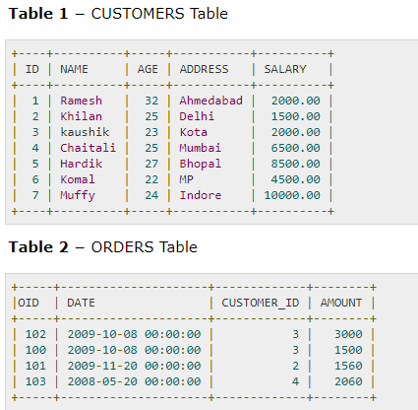

Slide 3
Join using select statement
SELECT ID, NAME, AGE, AMOUNT FROM CUSTOMERS, ORDERS WHERE CUSTOMERS.ID = ORDERS.CUSTOMER_ID;

Slide 4
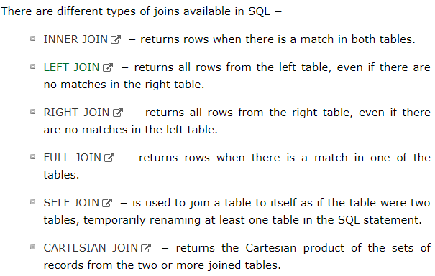

Slide 5
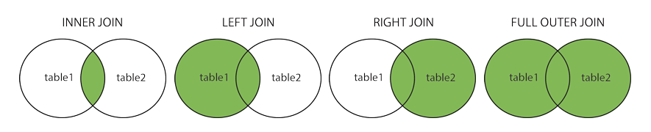

Slide 6
Inner Join
The most important and frequently used joins is the INNER JOIN. They are also referred to as an EQUIJOIN.
The INNER JOIN creates a new result table by combining column values of two tables (table1 and table2) based upon the join-predicate.
The query compares each row of table1 with each row of table2 to find all pairs of rows which satisfy the join-predicate.

Slide 7
Contd…
When the join-predicate is satisfied, column values for each matched pair of rows of A and B are combined into a result row.
SELECT ID, NAME, AMOUNT, DATE FROM CUSTOMERS INNER JOIN ORDERS ON CUSTOMERS.ID = ORDERS.CUSTOMER_ID;

Slide 8
Inner Join/ Equi Join
Inner join includes where clause in the select statement.
It is called equi join as the equality operator(=) is used in the where to compare two columns from two tables.
The rows that satisfies condition under where clause are selected.
Syntax:
Select table1.column, table2.column from table1, table2 where table1.column = table2.column;

Slide 9
Example of Inner join
Select Emp-id, Ename, Salary,Dname from Employee,Department where Employee.Dept_id=Department.Dept_id
Emp-id | Ename | Salary | Dept_id
101 | Anurag | 12000 | 01
102 | Anshu | 10000 | 01
103 | Manav | 15000 | 02
104 | Ankur | 8000
Dept_id | Dname
01 | Finance
02 | Marketing
03 | Packing
Department
Employee
Emp-id | Ename | Salary | Dname
101 | Anurag | 12000 | Finance
102 | Anshu | 10000 | Finance
103 | Manav | 15000 | Marketing
Result table

Slide 10
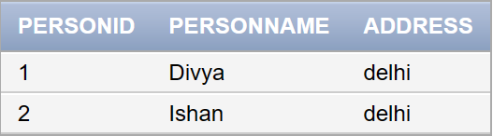
Example for Inner Join: e.g. Person1 table

Slide 11
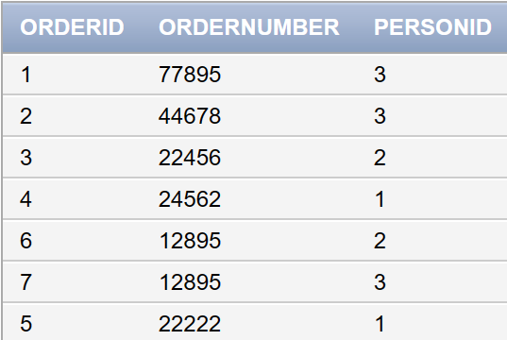
Contd… e.g. Orders table

Slide 12
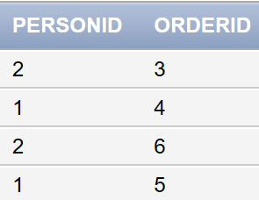
Contd…
Select person1.personid, orders.orderid from person1, orders where person1.personid = orders.personid;

Slide 13
Natural Join
Natural join is same as Inner join but the necessary condition is that the common column name should also be same along with its datatype
Example
select empid, ename, dname from employee natural join department

Slide 14
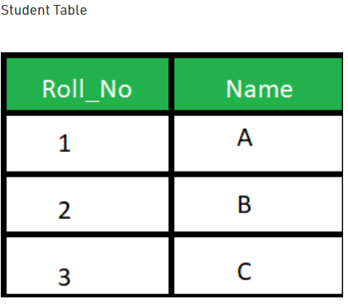

Slide 15
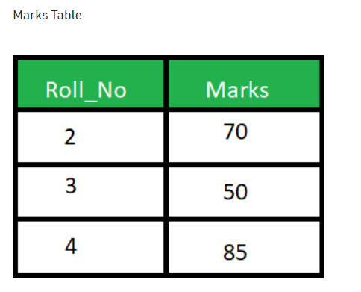

Slide 16
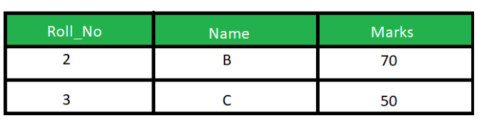
SELECT * FROM Student NATURAL JOIN Marks;

Slide 17
Outer Join
Outer join returns both matching as well as non-matching rows.
Here rows in one relation having non-matching rows in the other relation will also appear in the resultant tables with nulls.
Outer join is of 3 types:
Left Outer Join
Right Outer Join
Full Outer Join

Slide 18
SQL Left Outer Join
It returns all the rows in the first relation (i.e written on the left side) and if no matching rows is found in the second relation then attributes of second relation are filled with null values.
The SQL LEFT JOIN returns all rows from the left table, even if there are no matches in the right table. This means that if the ON clause matches 0 (zero) records in the right table; the join will still return a row in the result, but with NULL in each column from the right table.

Slide 19
This means that a left join returns all the values from the left table, plus matched values from the right table or NULL in case of no matching join predicate.
SELECT ID, NAME, AMOUNT, DATE FROM CUSTOMERS LEFT JOIN ORDERS ON CUSTOMERS.ID = ORDERS.CUSTOMER_ID;

Slide 20
Example of Left outer join
Select Emp-id, Ename, Salary,Dname from Employee left outer join Department on Emplyee.Dept_id=Department.Dept_id
Emp-id | Ename | Salary | Dept_id
101 | Anurag | 12000 | 01
102 | Anshu | 10000 | 01
103 | Manav | 15000 | 02
104 | Ankur | 8000
Dept_id | Dname
01 | Finance
02 | Marketing
03 | Packing
Department
Employee
Emp-id | Ename | Salary | Dname
101 | Anurag | 12000 | Finance
102 | Anshu | 10000 | Finance
103 | Manav | 15000 | Marketing
104 | Ankur | 8000 | Null

Slide 21
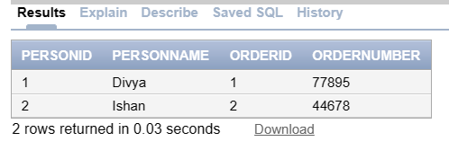
EXAMPLE FOR LEFT JOIN:-
SELECT person1.personid, person1.personname, orders.orderid, orders.ordernumber FROM person1 LEFT JOIN orders ON person1.personid = orders.orderid;

Slide 22
SQL Right Outer Join
It returns all the rows in the second relation (i.e written on the right side) and if no matching rows is found in the first relation then attributes of first relation are filled with null values.
The SQL RIGHT JOIN returns all rows from the right table, even if there are no matches in the left table. This means that if the ON clause matches 0 (zero) records in the left table; the join will still return a row in the result, but with NULL in each column from the left table.

Slide 23
This means that a right join returns all the values from the right table, plus matched values from the left table or NULL in case of no matching join predicate
SELECT ID, NAME, AMOUNT, DATE FROM CUSTOMERS RIGHT JOIN ORDERS ON CUSTOMERS.ID = ORDERS.CUSTOMER_ID;

Slide 24
Example of Right Outer Join
Syntax :
Select table1.columnname, table1.columnname, table2.columnname from table1 RIGHT JOIN table2 ON table1.columnname=table2.columnname;
Emp-id | Ename | Salary | Dept_id
101 | Anurag | 12000 | 01
102 | Anshu | 10000 | 01
103 | Manav | 15000 | 02
104 | Ankur | 8000
Dept_id | Dname
01 | Finance
02 | Marketing
03 | Packing
Department
Employee
Emp-id | Ename | Salary | Dname
101 | Anurag | 12000 | Finance
102 | Anshu | 10000 | Finance
103 | Manav | 15000 | Marketing
Null | Null | Null | Packing

Slide 25
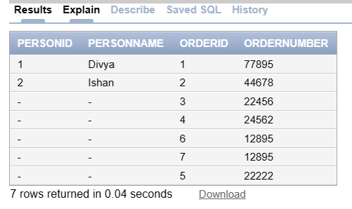
EXAMPLE FOR RIGHT JOIN:-
SELECT person1.personid, person1.personname, orders.orderid, orders.ordernumber FROM person1 RIGHT JOIN orders ON person1.personid = orders.orderid;

Slide 26
SQL Full Outer Join
The SQL FULL JOIN combines the results of both left and right outer joins.
It returns all the rows in both first and second relation and if no matching rows are found then it fills them with null values.
The joined table will contain all records from both the tables and fill in NULLs for missing matches on either side.
SELECT ID, NAME, AMOUNT, DATE FROM CUSTOMERS FULL JOIN ORDERS ON CUSTOMERS.ID = ORDERS.CUSTOMER_ID;

Slide 27
Example of Full Outer join
Select Emp-id, Ename, Salary,Dname from Employee full outer join Department on (Emplyee.Dept_id=Department.Dept_id)
Emp-id | Ename | Salary | Dept_id
101 | Anurag | 12000 | 01
102 | Anshu | 10000 | 01
103 | Manav | 15000 | 02
104 | Ankur | 8000
Dept_id | Dname
01 | Finance
02 | Marketing
03 | Packing
Department
Employee
Emp-id | Ename | Salary | Dname
101 | Anurag | 12000 | Finance
102 | Anshu | 10000 | Finance
103 | Manav | 15000 | Marketing
104 | Ankur | 8000 | Null
Null | Null | Null | Packing

Slide 28
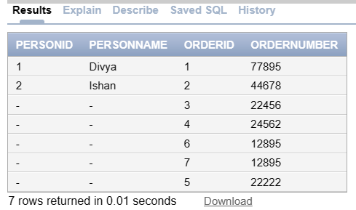
EXAMPLE FOR FULL OUTER JOIN:-
SELECT person1.personid, person1.personname, orders.orderid, orders.ordernumber FROM person1 FULL OUTER JOIN orders ON person1.personid = orders.orderid;

Slide 29
SQL Self Join
The SQL SELF JOIN is used to join a table to itself as if the table were two tables; temporarily renaming at least one table in the SQL statement.
SELECT column_names FROM Table_name T1, Table_name T2 WHERE condition ;
Syntax for Self Join:
SELECT a.column_name, b.column_name... FROM table1 a, table1 b WHERE a.common_field = b.common_field;

Slide 30
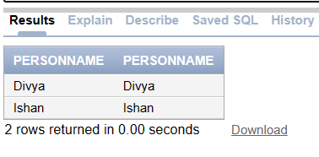
Example for Self join:
SELECT a.personname, b.personname FROM person1 a, person1 b WHERE a.personid= b.personid;

Slide 31
SQL Cartesian or Cross Join
The CARTESIAN JOIN or CROSS JOIN returns the Cartesian product of the sets of records from two or more joined tables. Thus, it equates to an inner join where the join-condition always evaluates to either True or where the join-condition is absent from the statement.
SELECT ID, NAME, AMOUNT, DATE FROM CUSTOMERS, ORDERS;

Slide 32
Cross Join/ Cartesian Join
Join operation in SQL is used to combine multiple tables together into a single table.
If we use the cross join to combine two different tables, then we will get the Cartesian product of the sets of rows from the joined table. When each row of the first table is combined with each row from the second table, it is known as Cartesian join or cross join.

Slide 33
If there are two records in table 1 and three records in table 2, then after performing cross join operation, we will get six records in the final table.
Syntax for Cross Join:
Select * from person1 CROSS JOIN Orders;

Slide 34
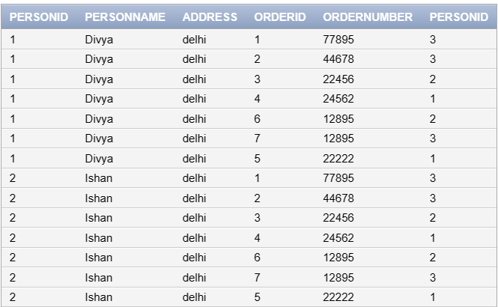
CROSS JOIN of Person1 and Orders table:

